Slide 1

Balanced scorecard slide 1
हाम्रो FARE
Your Travel Partner
THE INVICTUS CODE

Slide 2
Balanced scorecard slide 2
Vision and Value Proposition
Digital bus fare payment system
Efficient, easier and convenient
Monetary accuracy
Transparency

Slide 3
Balanced scorecard slide 3
The Problem
Conventional payment system
Time consuming
Hassles faced while hands-on payment
Self-ruling demeanor of the co-drivers
Limited within one public transportation organization
No specific user dedicated card

Slide 4
Balanced scorecard slide 4
Target Market
People who use public transportation services in the Kathmandu Valley.

Slide 5
Balanced scorecard slide 5
The solution
हाम्रो fare
Uses smart card
Automatic fare deduction after each travel
Systematic
Transparency
Not limited within one public transportation organization
Specific user dedicated cards
TOTALS

Slide 6
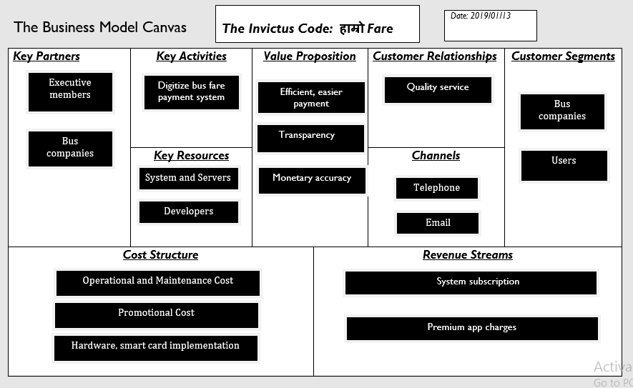
Balanced scorecard slide 6
Business model

Slide 7
Balanced scorecard slide 7
Traction and Validation/Roadmap
Tasks Completed:
Prototype (minimum viable product)
Login system
Database design
Website

Slide 8
contd…
Tasks to be completed:
Hardware Integration
Google API Integration
Mobile Application Development

Slide 9
Balanced scorecard slide 10
THANK YOU

